Slide 1
goFit:
Low-fi Testing
Bryce Tham | Christina Ramsey
Denis Russu | Olivia Gregory

Slide 2
Overview
Mission
&
Interface
Prototype &
Tasks
Testing
&
Results
Notes:
First I’ll reiterate our groups mission for our product, and the interface we chose to go with
The I’ll introduce the prototype and tasks we chose to test with our users
And lastly I’ll describe our testing method and conclude with our findings

Slide 3
Mission Statement
“Providing inspiration to maintain a healthy lifestyle”
Notes:
Users want to be healthy, but just need a little more incentive. We aim to inspire our users to maintain a healthy lifestyle, through gamifying their health and making them feel like maintaining their health is less of a chore and more of an activity
Secondary: Also some overlap with first group… potential for insurance incentives

Slide 4
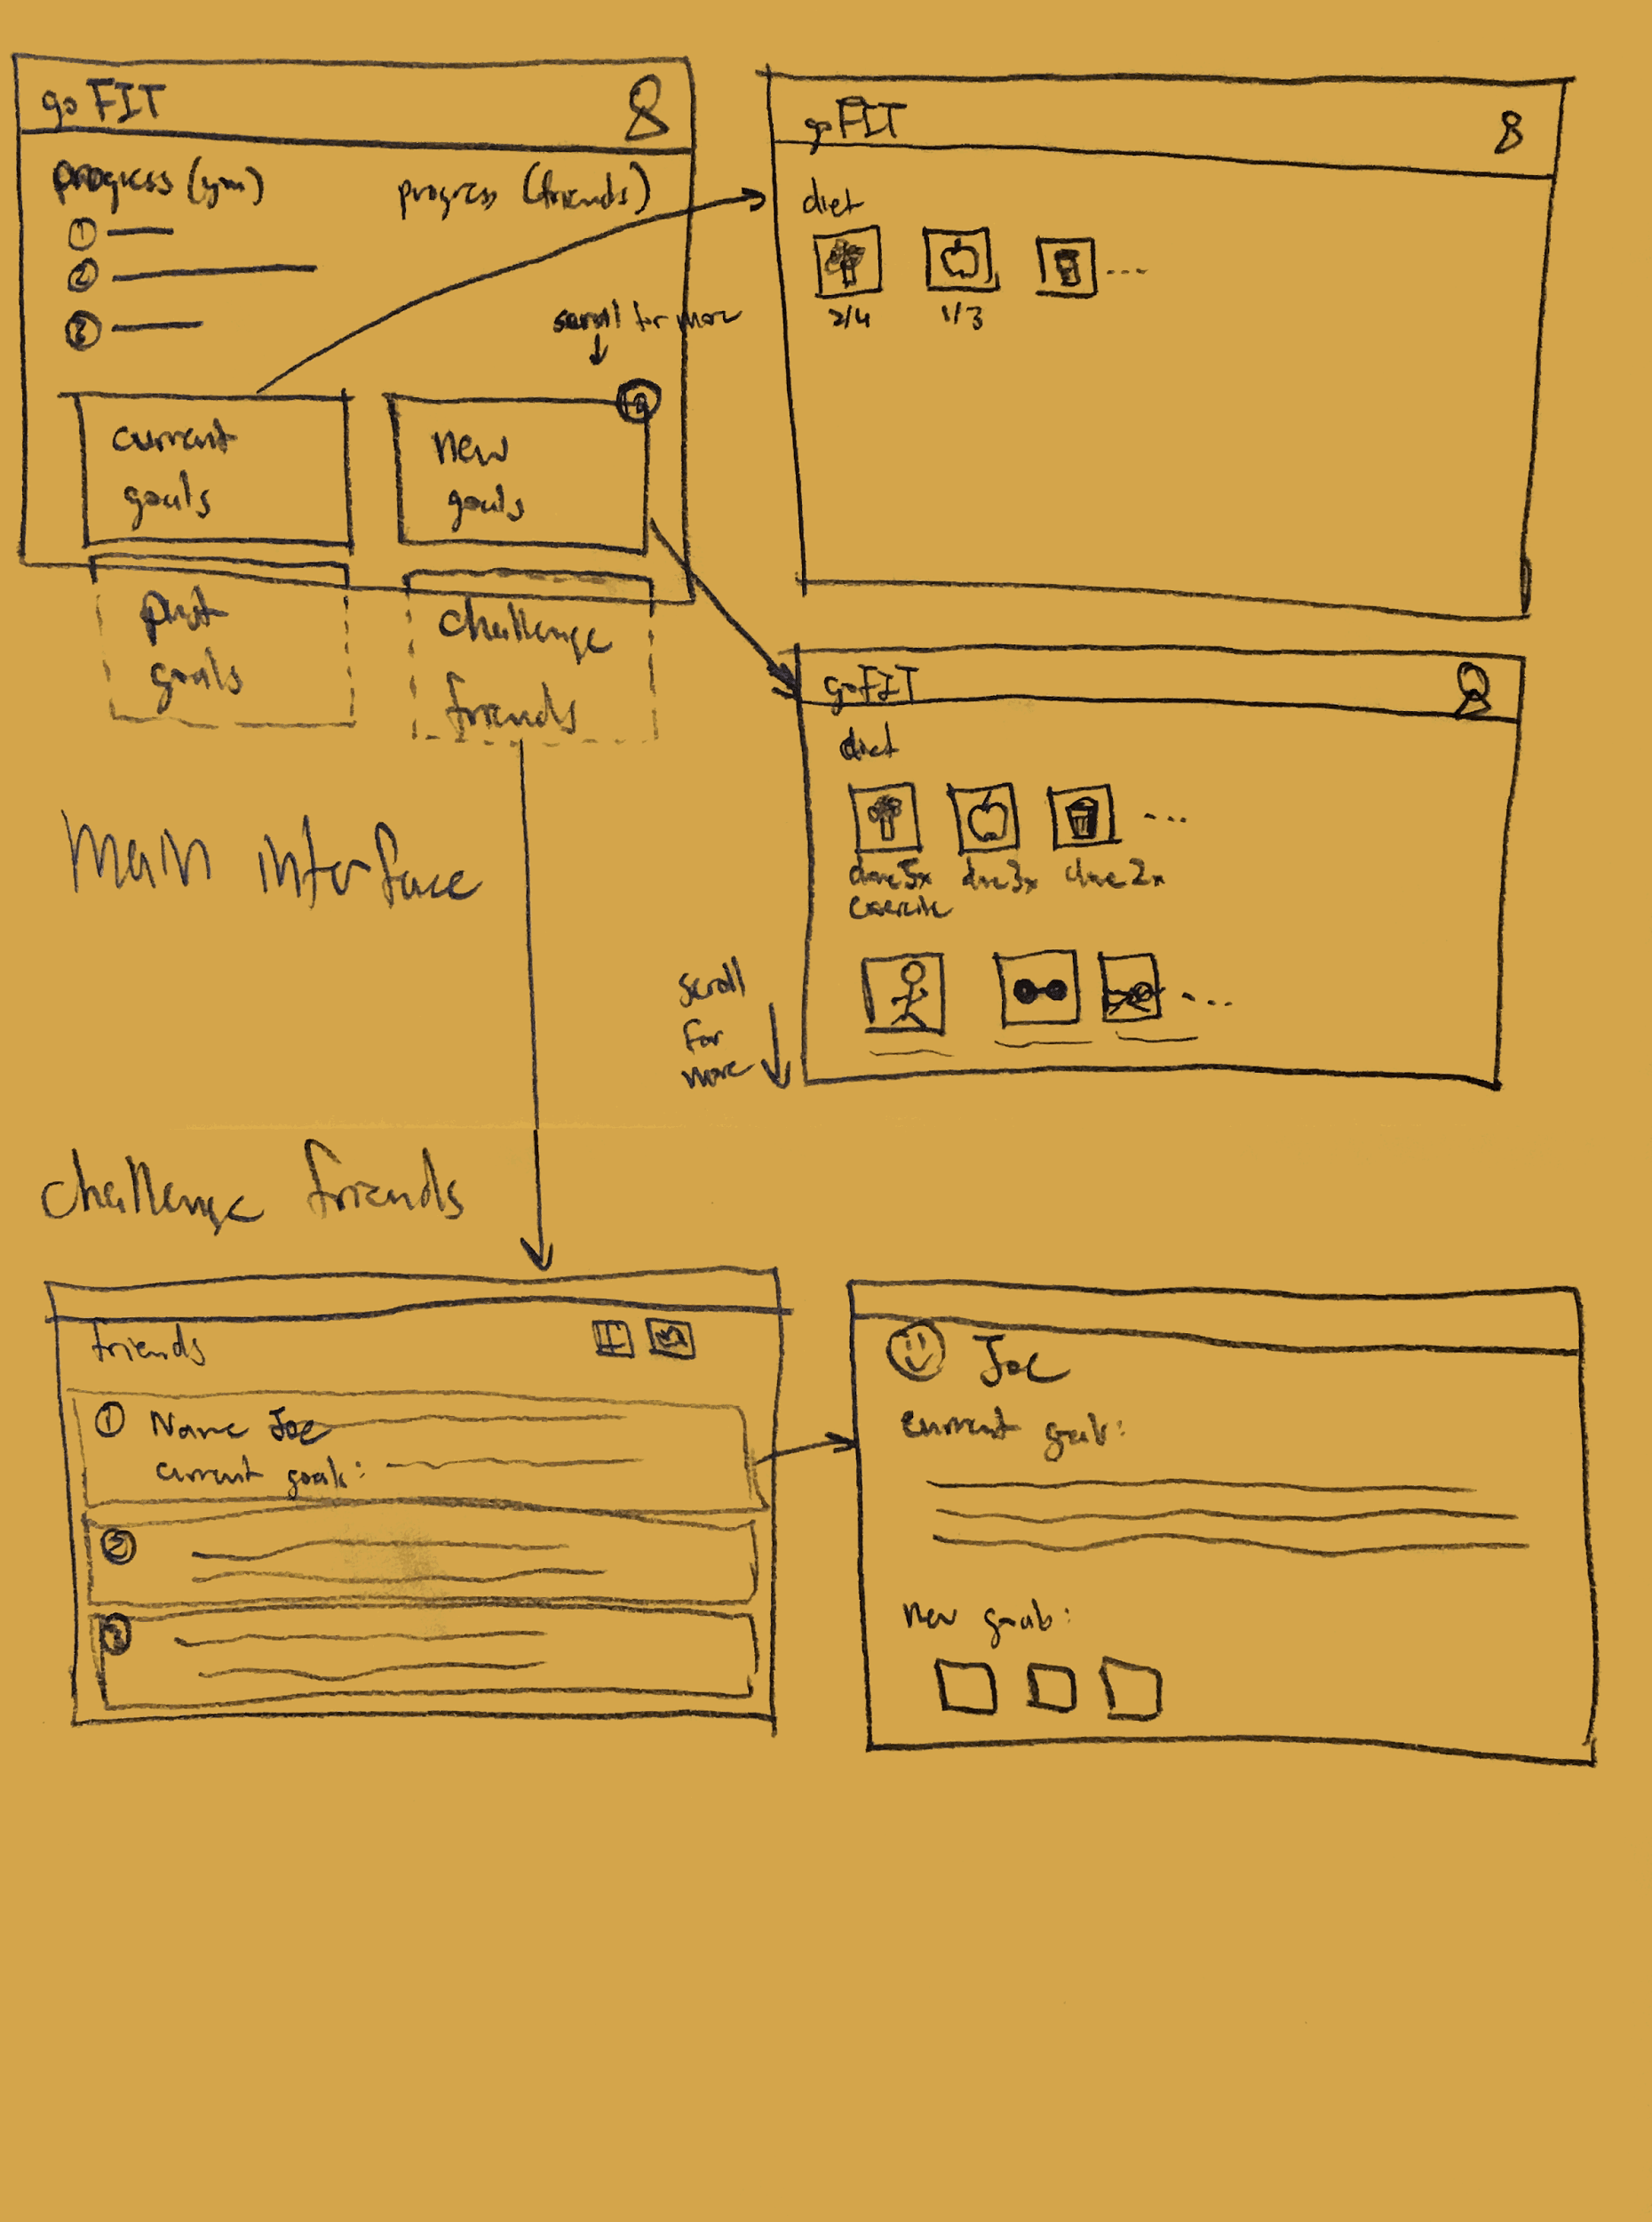
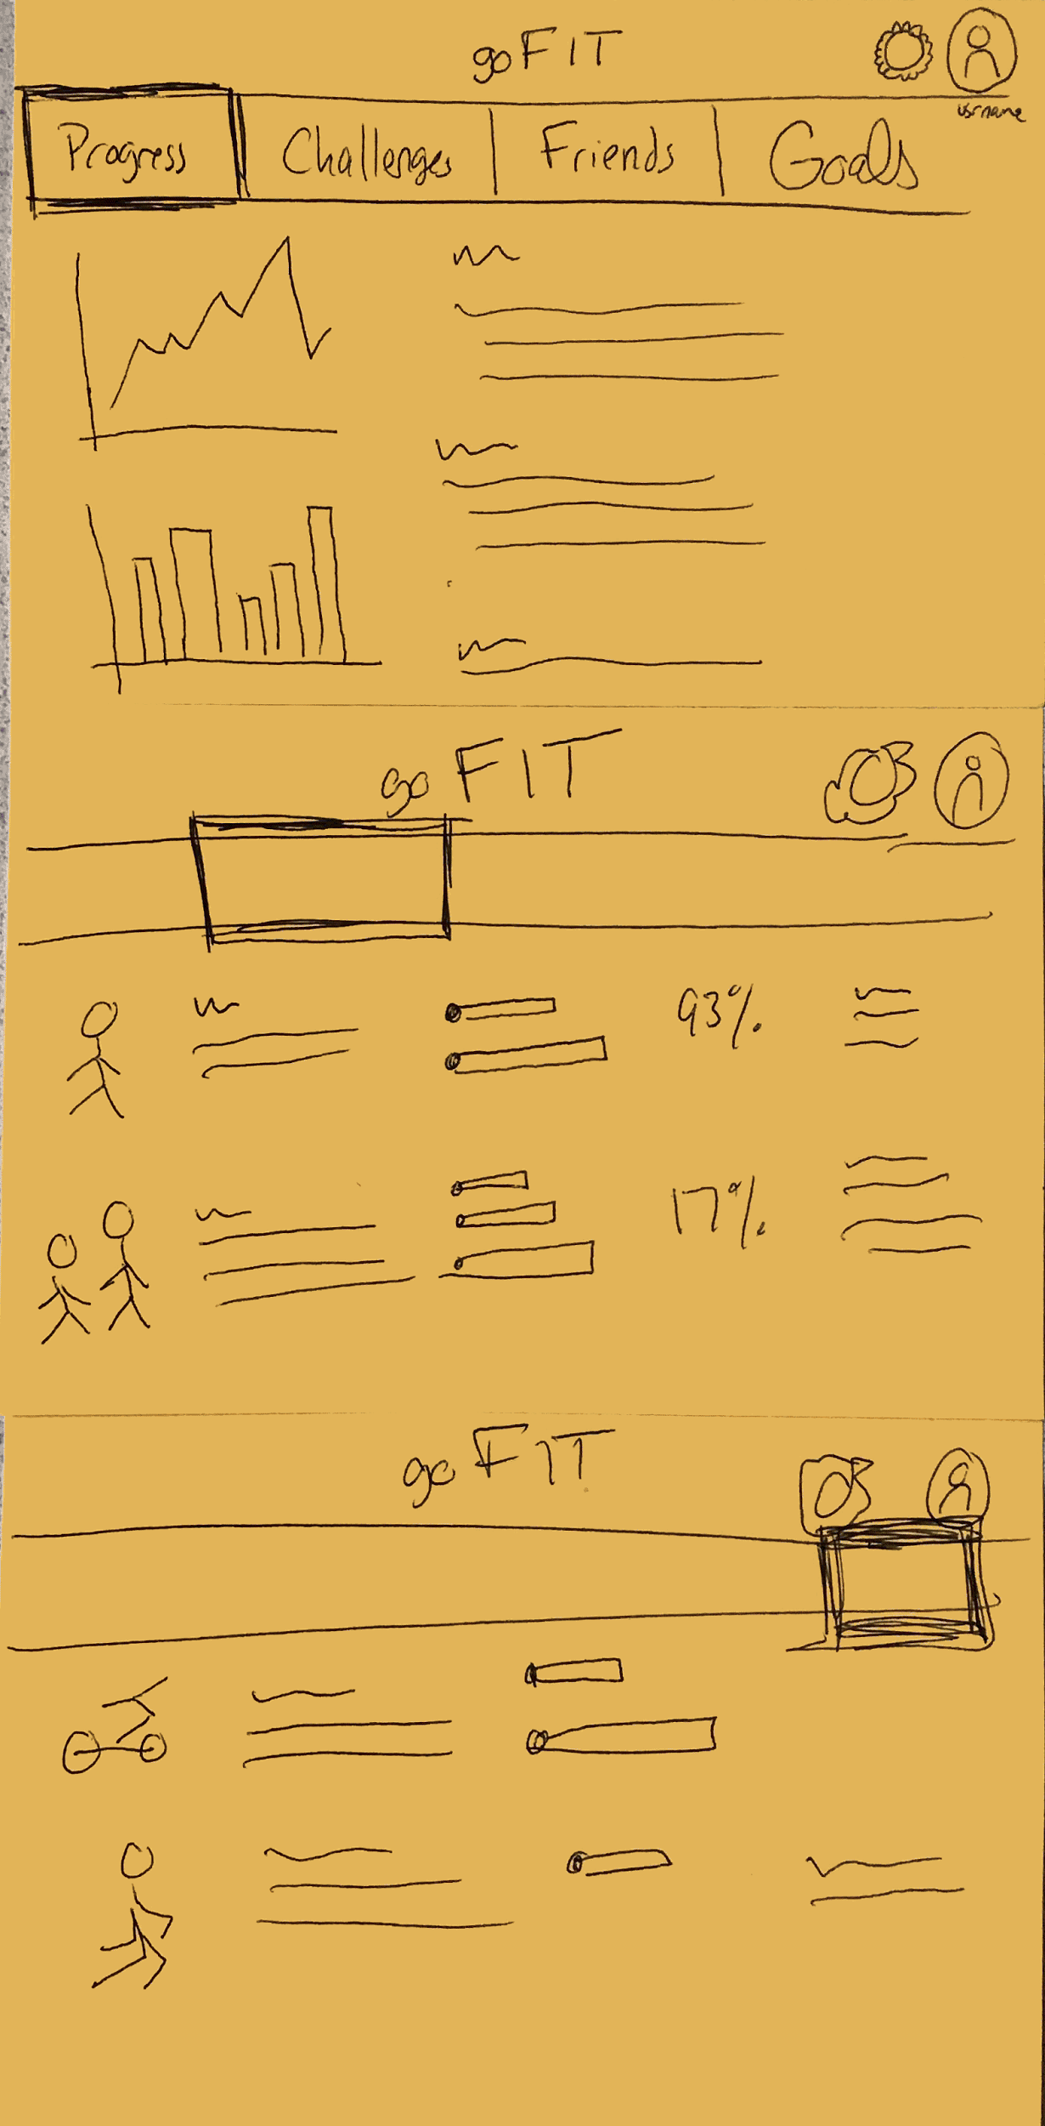
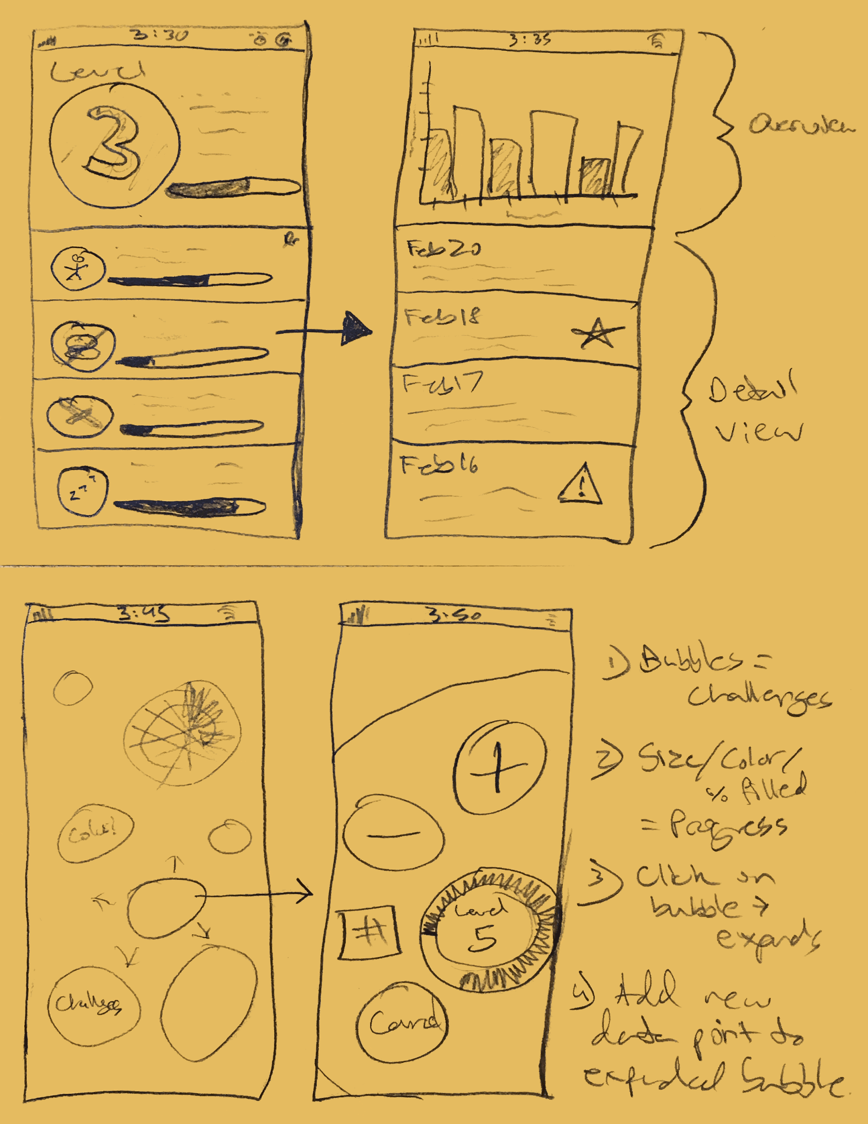
Interface?
Web
Tablet
Mobile
Notes:
WEB
The-first interface-idea-we brainstormed-was-a-web-app. The-main-page-focused-on-a-user’s current-progress,-both-in-individual-and-pair/group-challenges.-Below-that,-links-led-to-different pages,-with-each-page-focusing-on-a-specific-function-or-task.
TABLET
This-idea-was-similar, but-the-interface-design-centered-around-having-an-organized-taskbar- that-separated-functions-into-distinct-categories.-Unlike-the-mobile-design-above,-these sketches-conveyed-a-more-text--and-data-focused-tabular-setup.
MOBILE
Practically,-we-thought building a mobile app would be best. Because everyone carries their phone, even when they work out or go to the gym, this would be the simplest way of logging activities. Here we created a mobile interface, this one automatically able to sense and track progress on goals. Users can log data and view challenges and history. This design incorporated table rows and circular buttons, which looks more interesting, has more personality, and seems less generic than standard apps.
Not shown:
STANDARD MOBILE:
This design features a way to view and challenge friends to different activities, message them, and check their progress in current challenges.
AR:
We also brainstormed an AR idea. When exercising, a user wears a pair of glasses and views the current positions of other profiles involved in this challenge to compare their progress with his own. It also gives dietary and nutrient information when looking at food, helping users build a healthy meal.

Slide 5
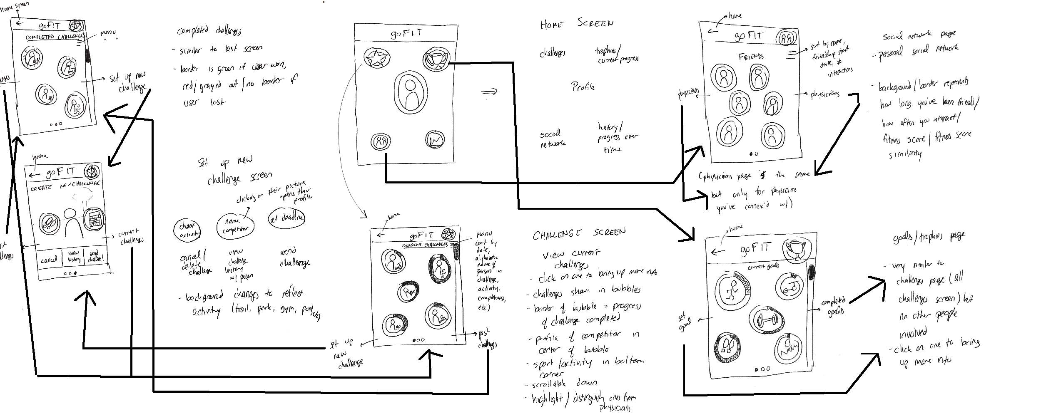
Bubble Mobile!
Notes:
Chose the best concepts from our brainstorms to draw out in detail.
Bubble Mobile:
This-idea-is-image-oriented, focusing-on-easy-navigation. It-is-simpler, emptier, and-prioritizes ease-of-use, with-the-experience-based-around-a-single, central-dashboard.
Other Design (Boxy), Not shown:
This-idea-was-goal-heavy,-focused-on-giving-the-user-as-much-information-as-possible-and allowing-them-maximum-control-over-their-experience. The-design-is-tabular, image-heavy, and navigable-by-menu.
WHY WE CHOSE BUBBLE (RATIONALE IS IMPORTANT, IT’S ON YOUR RUBRIC):
Eventually our bubble mobile design won, since ease of use and approachability were our most important factors. While our product will absolutely have all the data and history accessible for expert, we wanted the primary interface to be easily navigable and friendly, allowing new users easy access.
Feedback from interviews showed that many want to exercise but don’t. We want users to feel rewarded when they track, progress on, and complete challenges; we don’t want using our app to be a challenge in and of itself.
We also considered that we want users to constantly have our product readily available, which is why the mobile app design won. Finally, we liked that the circular design had a more defined personality and felt less generic than the first.

Slide 6
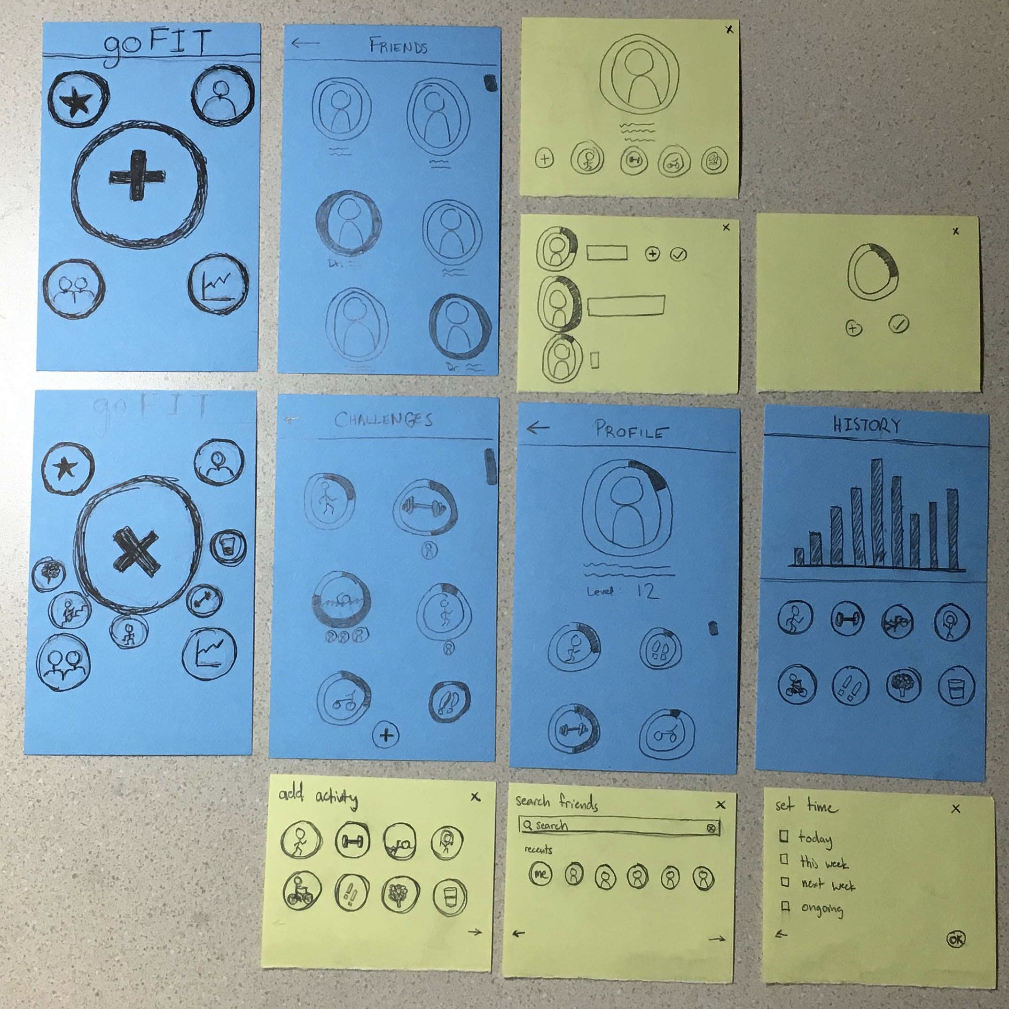
Prototype Structure
Mimics mobile interaction
Focus on simplicity and ease of use
Notes:
Our prototype mimics a mobile based interaction. GPS sensors in the phone will allow it to track some activity (going for walks, bike rides, runs, hikes, etc) and automatically log those activities and progress. It also allows users to manually input fitness and dietary information as well as challenge friends in meeting fitness goals.
Ultimately, our-prototype-mimics-a-mobile-app-that-logs and-tracks-workouts. Since this is our focus, it is emphasized in our dashboard.
Users can track current and past challenges, as well as create new ones.
Users create a personalized profile shareable with friends.
Users build a network of friends/physicians who become a part of their experience.
They can track personal progress and fitness history.
Altogether, we are expecting each of these functionalities to contribute to our value proposition, inspiring users to maintain healthier lifestyles.

Slide 7
Task #1.
Start a personal goal

Slide 8
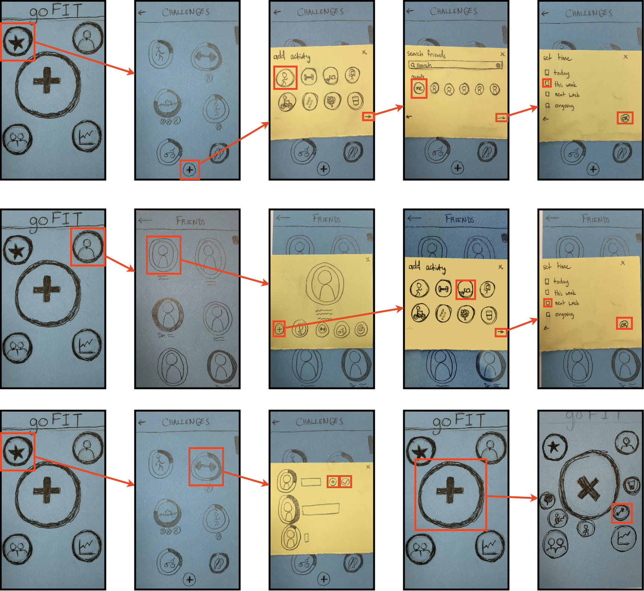
Task #1 Flow
Easily create a goal, add options if desired
Notes:
To start a personal challenge, users click the challenge screen then the-add-challenge-button. In the modal view, they choose the activity, any users involved (for a personal goal, the only user is “ME”), and a deadline. Hitting “OK” starts the challenge.

Slide 9
Task #2.
Challenge a friend

Slide 10
Task #2 FLow
Making fitness social is key
Notes:
Challenging a friend could follow the same task flow as challenging yourself; since these are the main functions of our app, we wanted all paths that could intuitively lead to this task to do so. Here, a user can challenge a friend by opening his friends list. When he clicks on a friend, a modal with that profile appears, and he can add a new challenge. From there, he chooses the activity and the deadline before sending the challenge.

Slide 11
Task #3.
Log activity progress

Slide 12
Task #3 Flow
Detailed log
Quick log
Notes:
Interviewees say that logging activity is a pain. We wanted to make it as easy as possible by omitting extra views, making it the main focus on opening our app, and creating many ways to complete this task.
In the detailed log, the user opens his challenges, clicks the challenge where he wants to log activity, and either adds activity or logs he’s completed the challenge in the pop-up-box.
In the quick log, the user clicks the main add circle; favorited challenges pop up on the home screen and the user can click one to log activity.

Slide 13
Testing
A mother who exercises regularly in fitness classes
Physicist who encourages family to exercise… but doesn’t himself
A young mechanical engineer
All tests carried on in a quiet indoor environment
Analyze interactions to improve user experience
Notes:
In testing our low-fidelity prototype, we wanted to observe how a variety of users interact with our application. Our goal was to determine what improvements could be made to enhance the overall user experience.
In particular, we wished to test how easily a user could perform the 3 tasks discussed above. We fleshed them out, making them more specific to avoid any ambiguity:
Start a personal running challenge for this week.
Start a swimming challenge with a friend for next week.
Log progress on your current weightlifting challenge.
The primary metrics we used were:
time spent performing the task (we want the user to get things done in the application quickly and intuitively), and
how many times the user went to the wrong screen (which would mean the user interface was confusing in some particular aspect).
Overall, we wanted to see if users accomplished our tasks easily, with minimal help.
Our participants were kind enough to willingly donate their time to us when approached in person, and we compensated them by offering to treat them out for food or coffee.

Slide 14
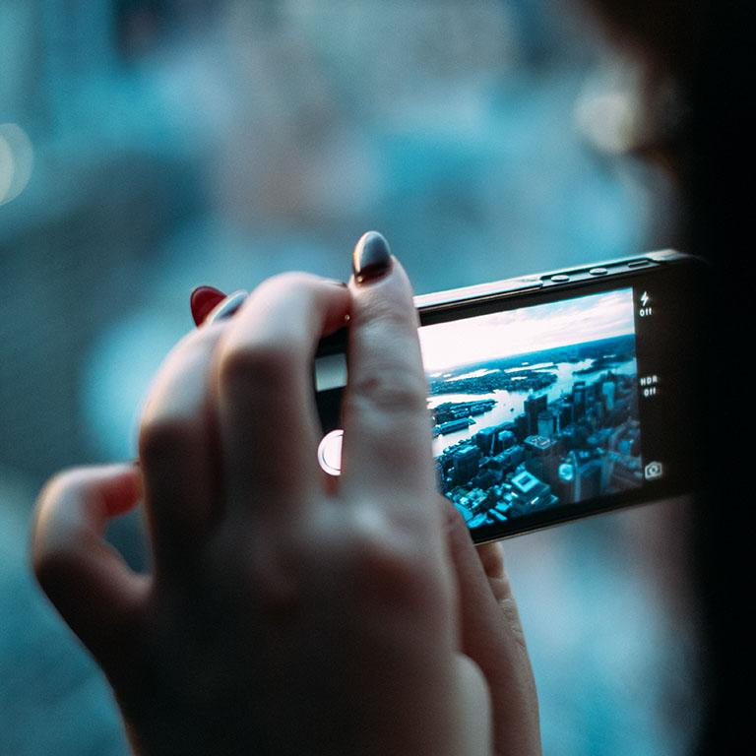
Results
Simple means when it works, it works really well… when it doesn’t, it’s confusing
Multiple paths for single tasks may be key to an intuitive app
Very little friction once users got past the home page
Long-term potential is essentially impossible to evaluate at this stage
Notes:
Users got stuck on the + button a lot, it’s functionality wasn’t as clear as we hoped it would be, and the button is really at the core of our app so this is important
The icons on the home screen in general weren’t as crystal clear as we assumed they were
One thing that stuck out to us when observing users performing task 1 was how quickly they were able to complete it upon getting past the main screen. There seemed to be a logical flow of the views and modals that made sense to every user we tested, and there was almost no confusion whatsoever about how to complete the task

Slide 15
Changes for next iteration
Either add labels to home screen buttons, or design icons that make functionality crystal clear
Large + button didn’t make logging activities quite a easy as we wanted… is there a way we could make it easier/more natural?
Will keep the storyboards in general, users were pleased with the flow of the tasks

Slide 16

Questions
&
Comments

